Slide 1
Graphics Pipeline: Hierarchy
3D Vision Induction - Day 2

Slide 2
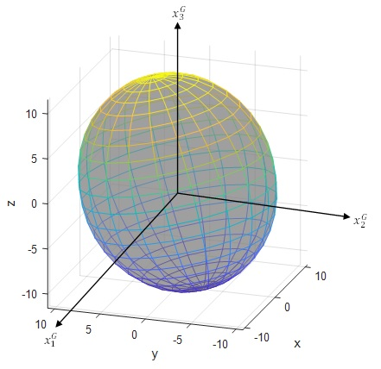
Modelling objects in their coordinate system

Slide 3

The World Coordinate system

Slide 4
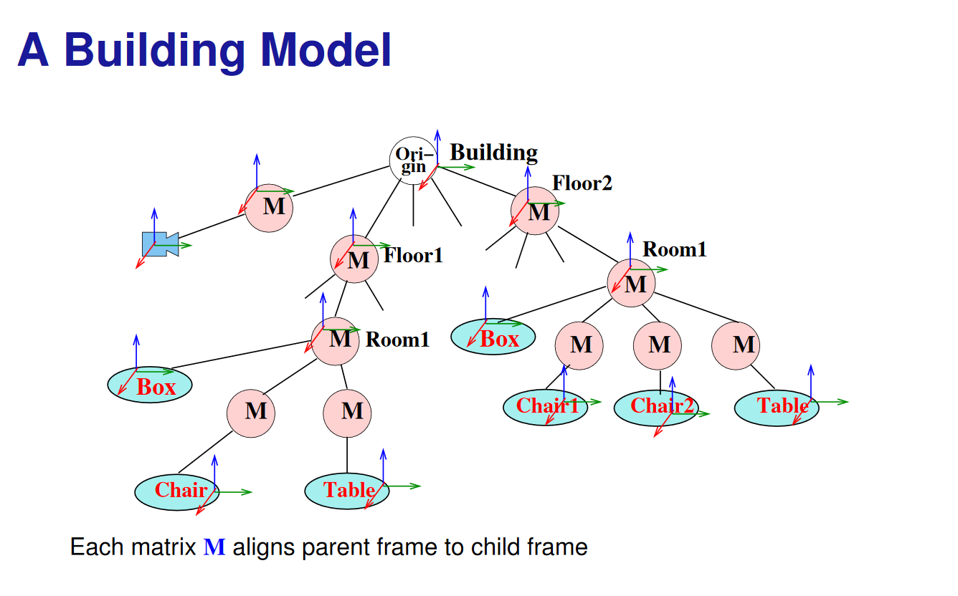

Slide 5
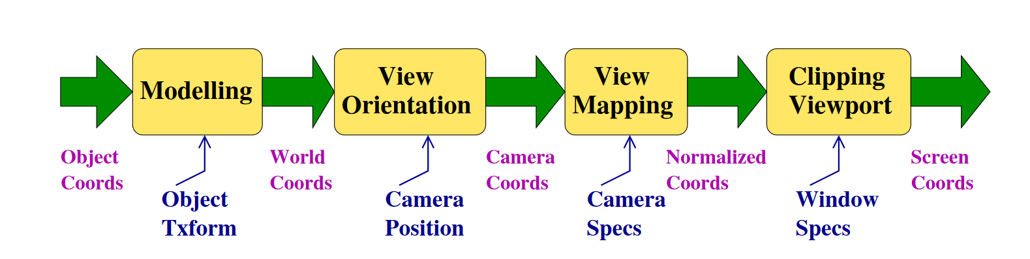
Coordinate Systems
Objects are specified in their own coordinate system and placed in the world coordinate frame.
Camera is also placed in the world coordinate frame.
Camera-to-world geometry is first projected to normalized coordinates and then to screen.

Slide 6
Coordinate Systems
Object Reference: Object is described in an internal coordinate frame called ORC
World: Common reference frame to describe different objects, called WC
Camera/View Reference: Describe with respect to the current camera position/orientation, called VRC
Normalized Projection: A standard space from which projection is easy, called NPC
Screen/Window: Coordinates in the output device space.

Slide 7
Transformations
Modelling: Convert from object coordinates to world coordinates (ORC to WC).I
View Orientation or Viewing: From world coordinates to camera coordinates (WC to VRC).I
View Mapping or Projection: From VRC to Normalized Coordinates (NC).I
Viewport: From NC to window coordinates.

Slide 8
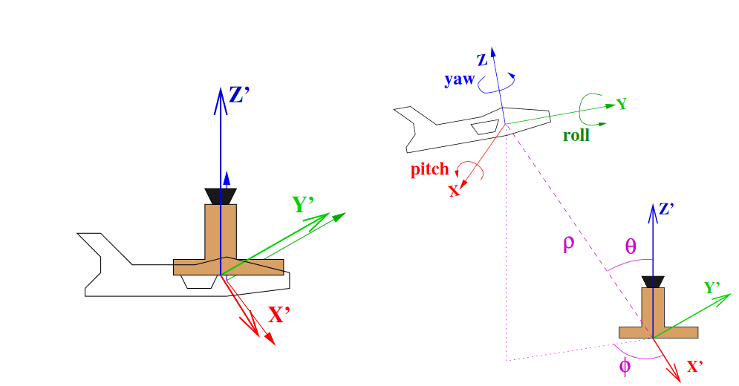
Modelling Example: Aircraft in a Polar World
WC frame on ground, ORC frame on the
aircraft.
Controllers think in polar coordinates for
position and
roll-pitch-yaw for orientation.
What are the modelling steps?
We can start at origin and change the coordinates accordingly

Slide 9
Modelling Steps for Aircraft in Polar World
Start with both axes aligned
Translate to the location given by (ρ,θ,φ)
Apply yaw, pitch, and roll in that order. (Why?)
Coordinate axes undergoing transformation!
Net effect: T(ρ,θ,φ) Rz(y) Rx(p) Ry(r)
What is T(ρ,θ,φ)? Compute (x,y,z) and translate
Alternate: Rotate to align aircraft’s Z-axis to translation direction, translate by ρ and unrotate
T(ρ,θ,φ) = Rz(−φ) Ry(θ) T(0,0,ρ) Ry(−θ) Rz(φ)

Slide 10
Yaw, Pitch and Roll (Z, X, Y)
Let Y be East, X be South, and Z be Up
Consider a pitch of 30 degrees and a yaw of 90 degrees
Yaw followed by pitch: what happens?
Pitch followed by yaw: what happens?

Slide 11
Yaw, Pitch and Roll (Z, X, Y)
Let Y be East, X be South, and Z be Up
Consider a pitch of 30 degrees and a yaw of 90 degrees
Yaw followed by pitch: We can have the fight climbing 30° in desired direction
Pitch followed by yaw: what happens?

Slide 12
Yaw, Pitch and Roll (Z, X, Y)
Let Y be East, X be South, and Z be Up
Consider a pitch of 30 degrees and a yaw of 90 degrees
Yaw followed by pitch: We can have the fight climbing 30° in desired direction
Pitch followed by yaw: Flight winds up in similar direction with an undesired roll

Slide 13
Hierarchy of Transformations
We need a hierarchy of transformations to setup the objects in our scene with respect to the world coordinates
Think of an ant moving on a wheel, or the joints in the arm.
M = T1 T2 T3 ···
captures the composite transform as a shift in coordinate frames.

Slide 14
Modelling in OpenGL
OpenGL 3.0 takes a single matrix that transforms object coordinates to normalized projection coordinates directly.
You can devise separate Projection, Viewing, and Modelling matrices for ease of understanding
Multiply them into P V M and send to the shader
Shader transforms coordinates in the vertex array to projection/screen coordinates using this matrix
Modelling matrix for the aircraft in polar coordinates:
M = T RZ(y) RX(p) RY(r)

Slide 15
View Reference Coordinates
“The goal is to simulate what the camera should be seeing onto the screen, so we need to transform objects to the camera POV.”
-Me, this morning
Mapping WC to VRC

Slide 16
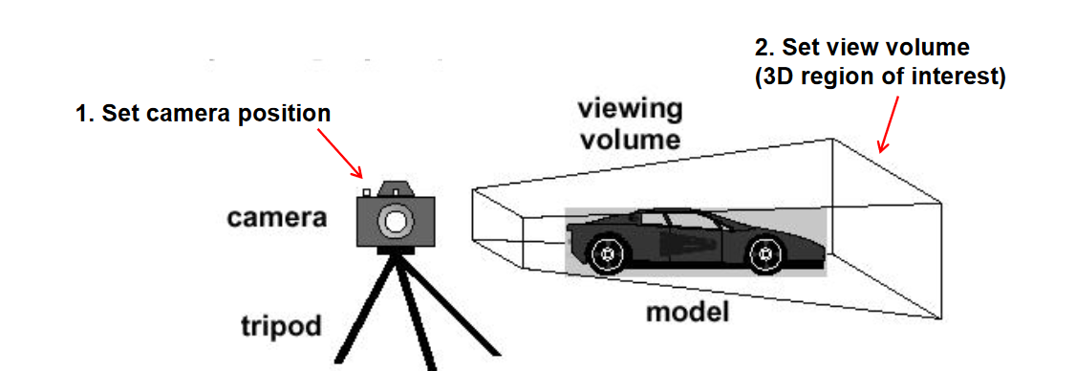
The concept of View Volume
Objects inside the view volume show up on screen
Objects outside the view volume are clipped

Slide 17

World Frame vs Camera Frame
Typically we describe a scene with respect to a set of world coordinates to assign a reference to the various objects in the scene.
But when we are describing what a user sees, it is more natural to think of the scene from their perspective.

Slide 18
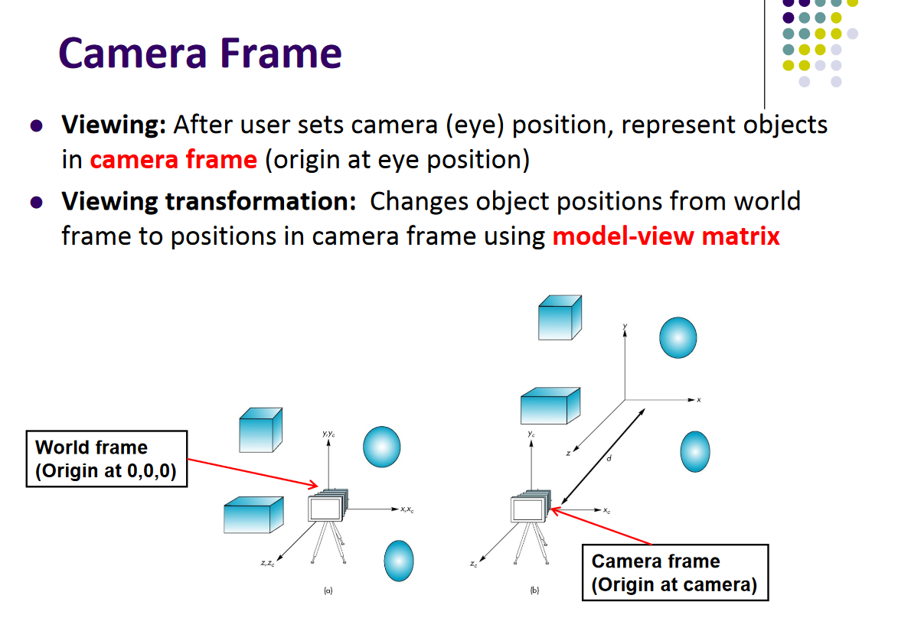

Slide 19
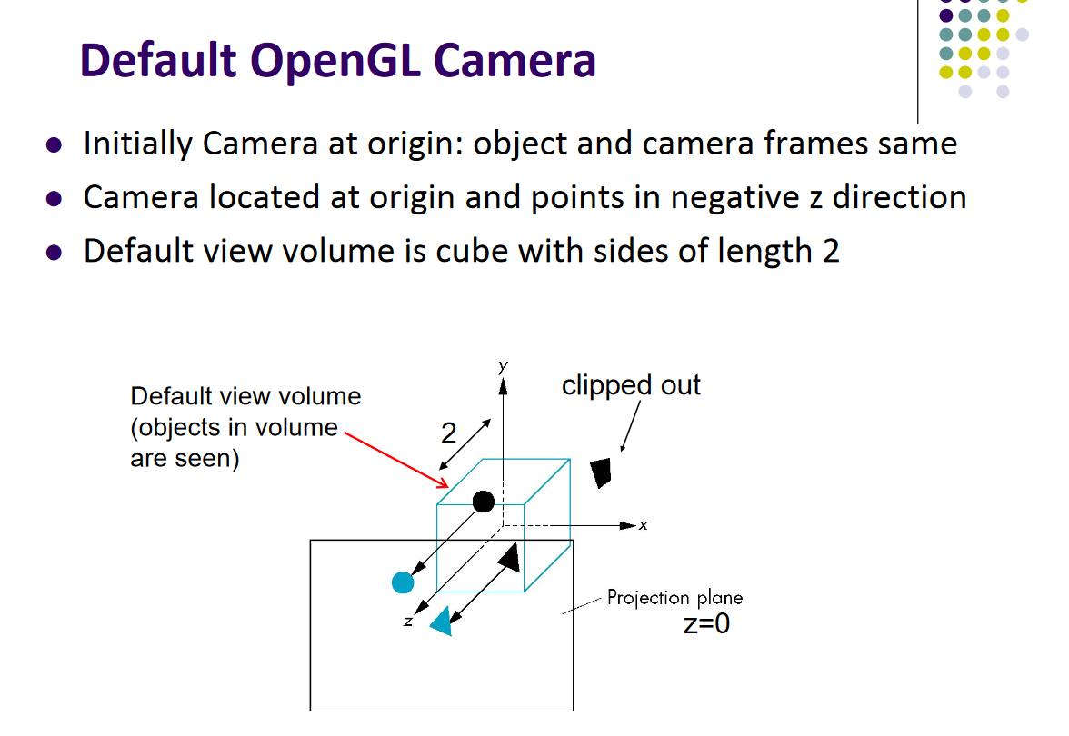

Slide 20
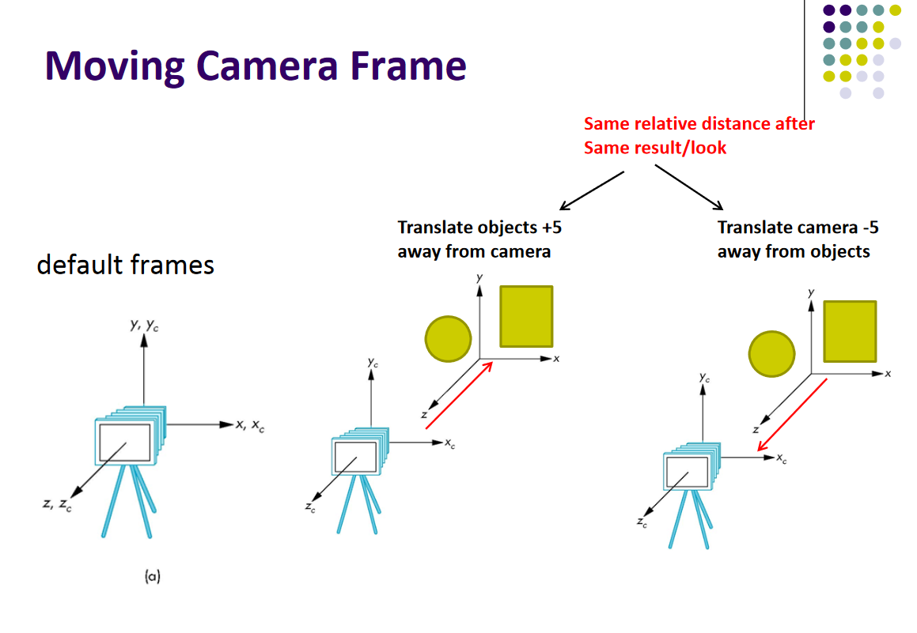

Slide 21
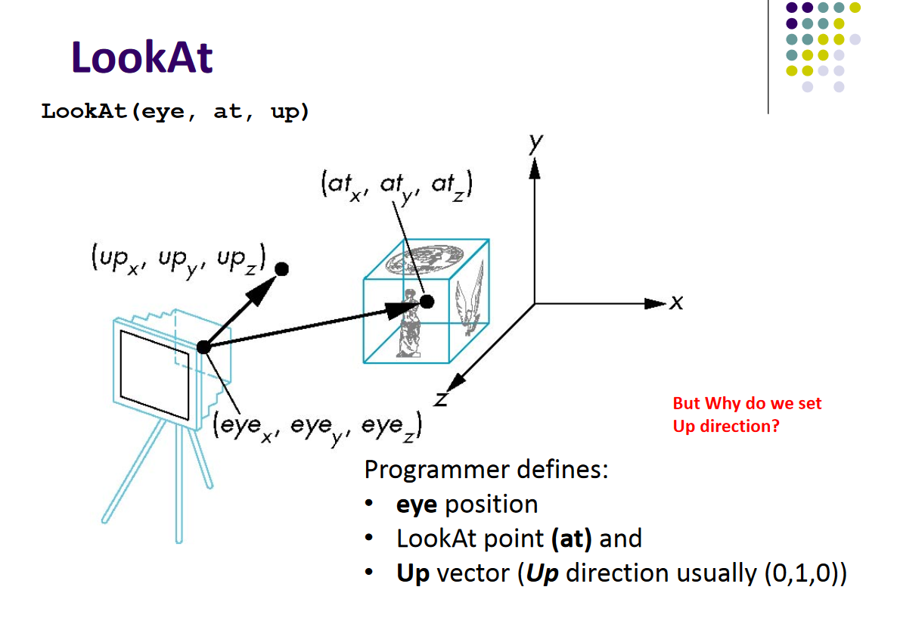

Slide 22
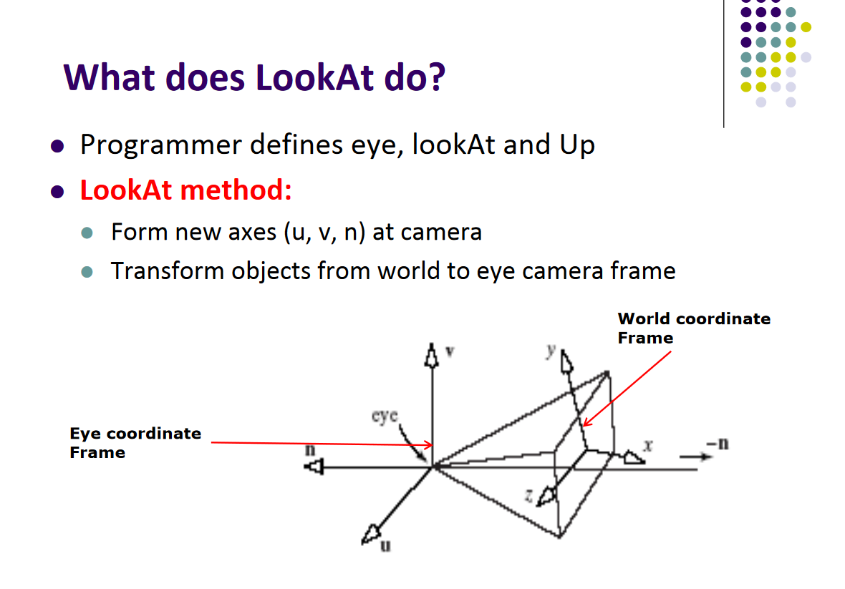

Slide 23
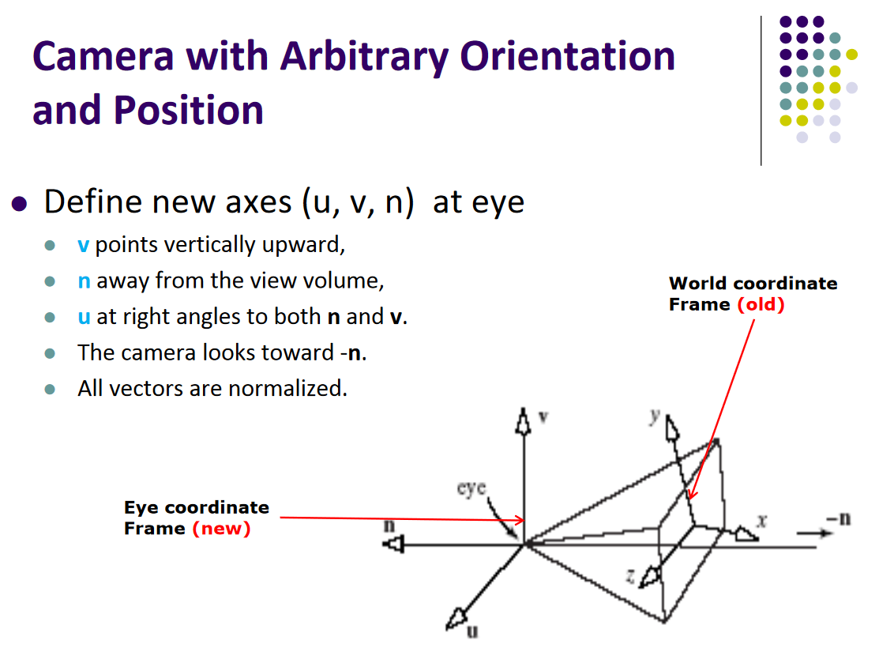

Slide 24
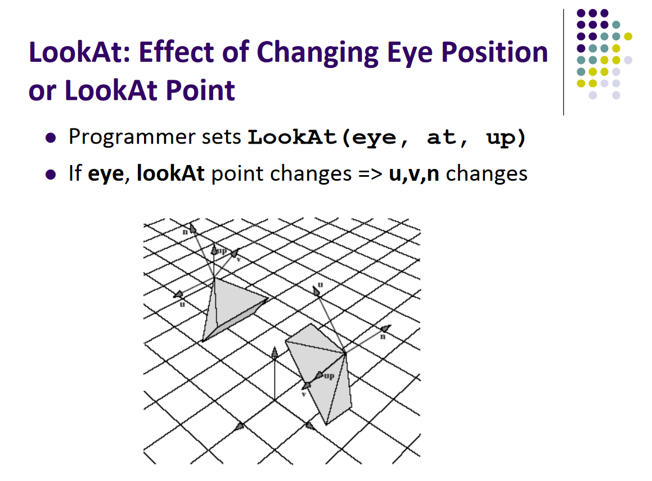

Slide 25
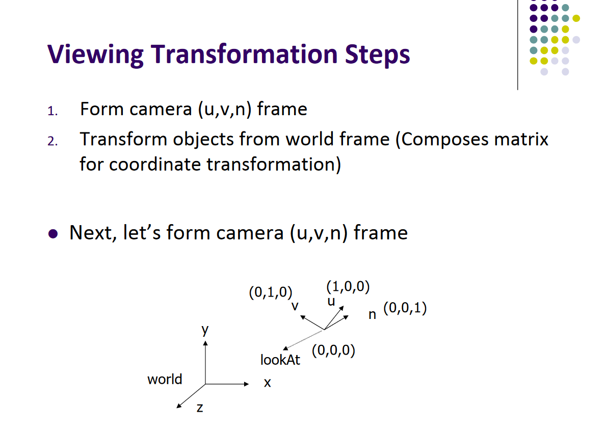

Slide 26
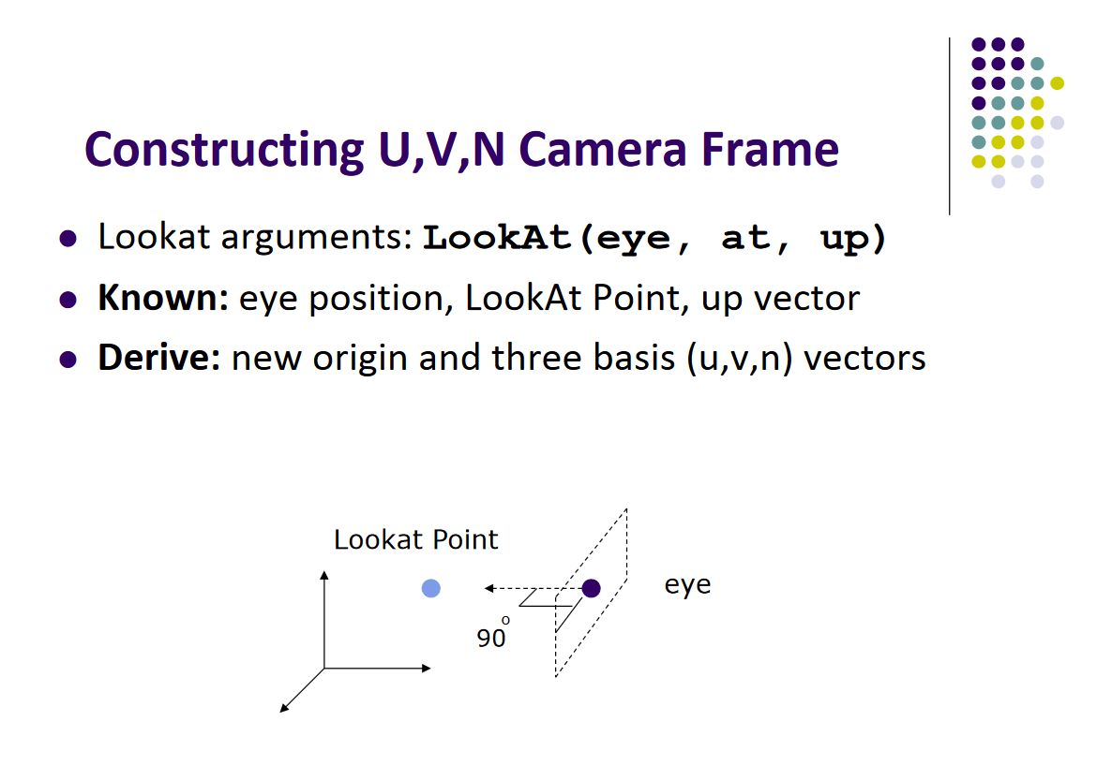

Slide 27
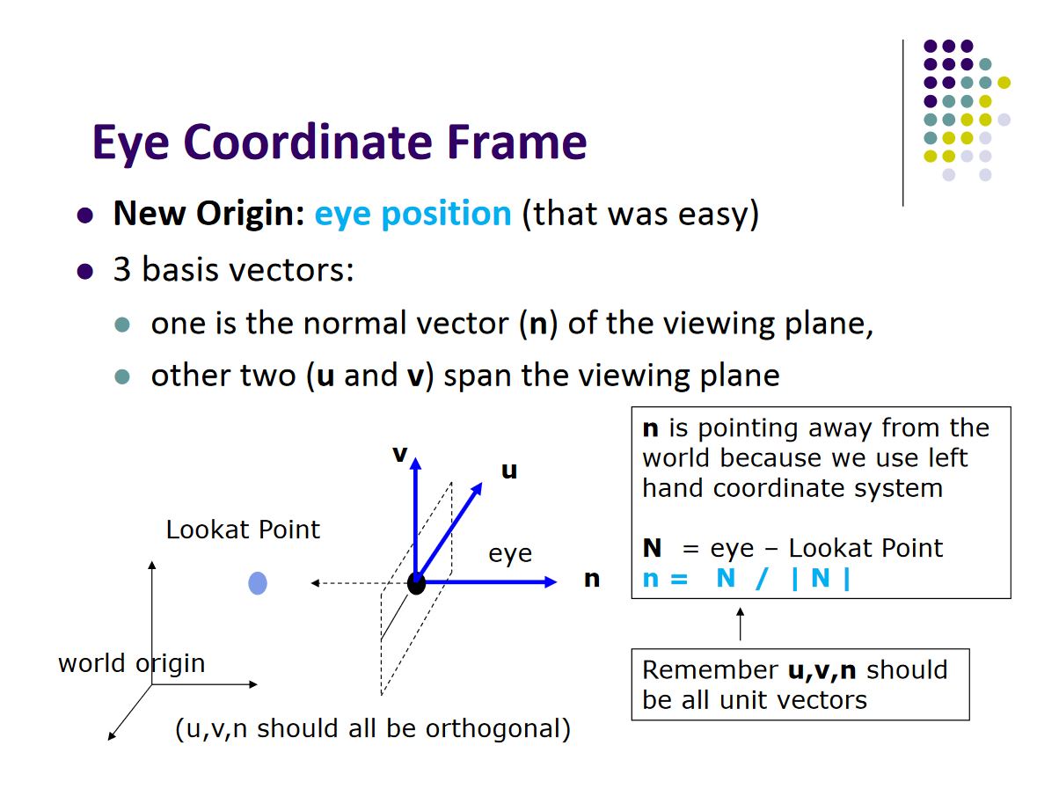

Slide 28
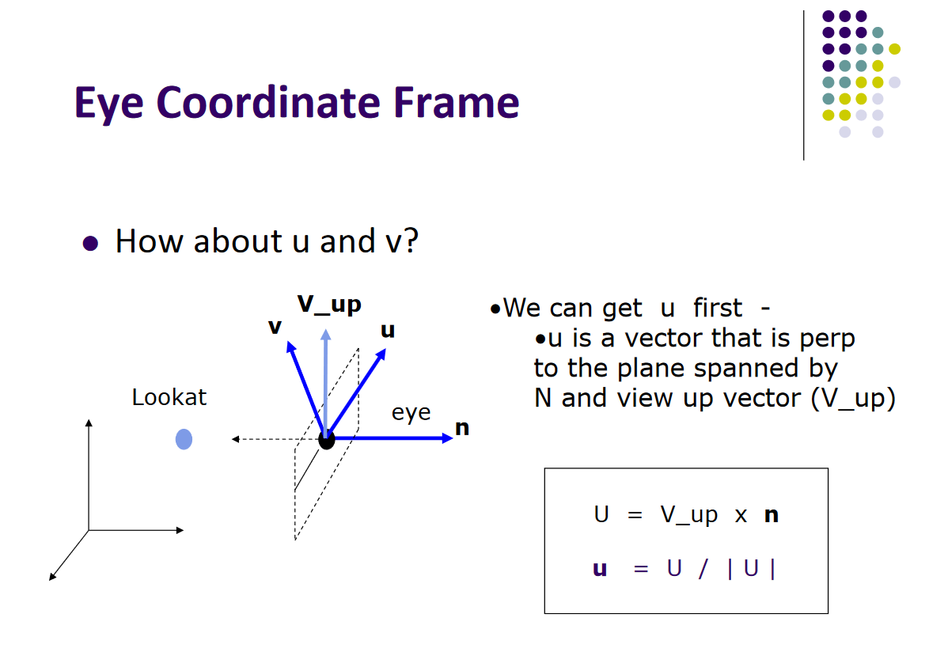

Slide 29
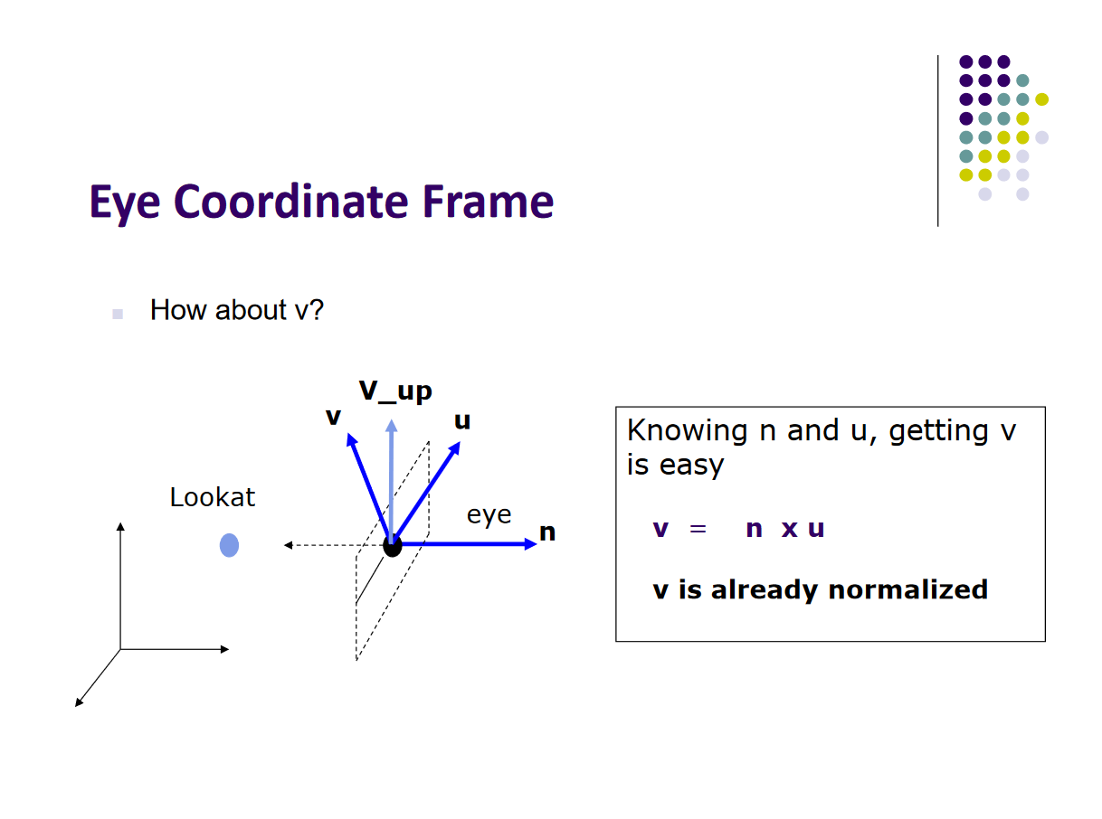

Slide 30
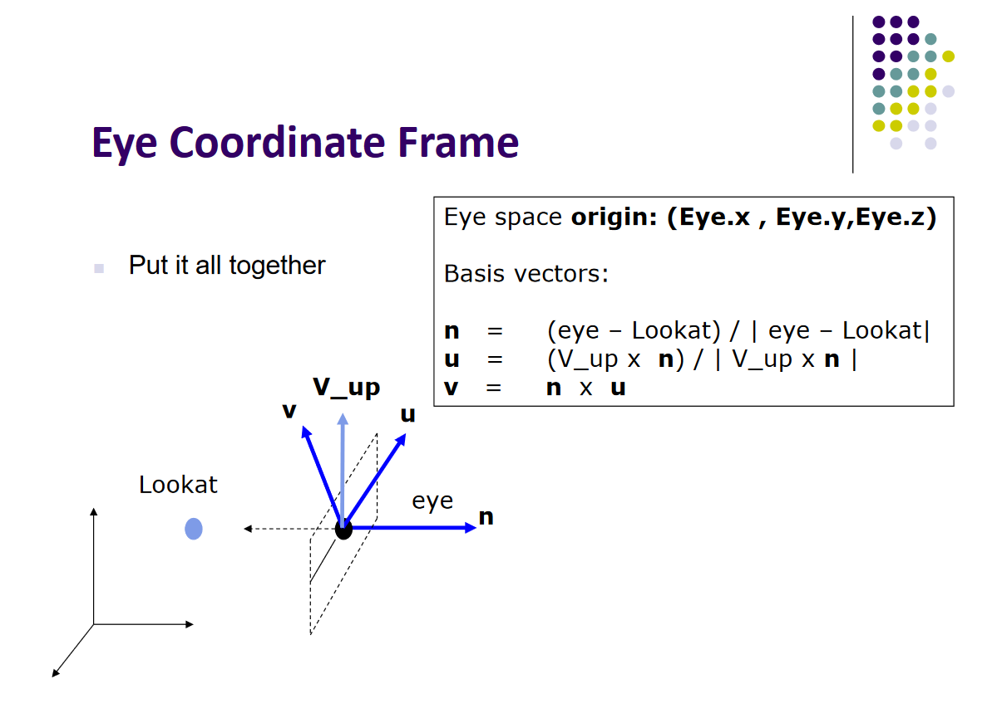

Slide 31
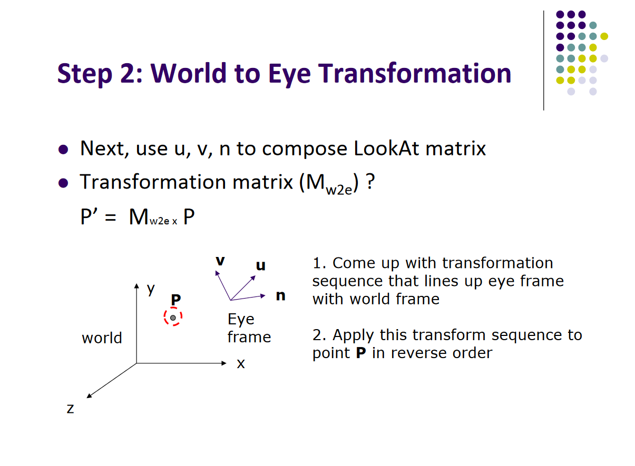

Slide 32
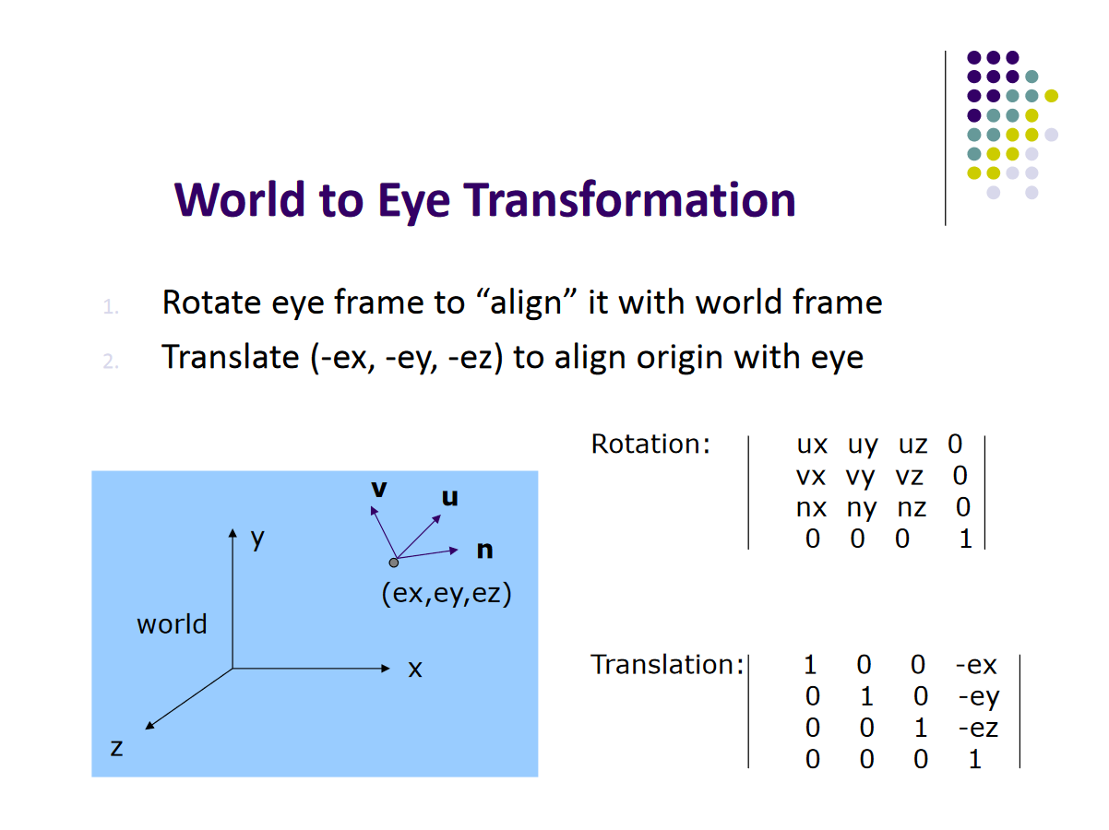

Slide 33
